Slide 1
Reliability and Performance Testing for Kubernetes Operators
Olga Mirensky
Platform Engineer, ANZ Plus

Slide 2


Agenda
Introduction
Why build operators
Operators performance
Performance testing
Testing frameworks
Q & A

Slide 3
API Driven Platform

Slide 4
Payment History
Manage Card Access
Cash without a card
Payment Limits
Settle Home Loan
Digital wallet
Refinance their home loan
Set up account
Money in money out
Card blocks
Explore the loan proposition
Activate Card
In app Card details
View and accept loan offer
Set up offset accounts
Pay off and close home loan
Appointment Booking
Manage their loan
Manage Payees
Transfer money BSB and ACCT#
Manage loan book pricing
Step up ID
Manage Pin
See interest rates
Fitbit Pay
Verify identity
Round Ups
Access a refinance coach
Loans
Spending Limits
Submit property insurance
Deceased Estates
Purchase a property and advise ANZ
Upcoming Expenses
Automated credit risk assessment
Power of Attorney
Create PayID
Share and export transactions
Financial wellbeing nudges
Finalise loan
Coaches workbench
Calculate, display and manage charges and interest on loans
Voice
Complaints
Exit a customer
Transact & Save
Replace Card
BPAY
Create Digital Identity
Recover credentials
Receive Card
NPS
Customer can be uniquely identified
WFM
International Money Transfer
Garmin Pay
Detect fraud, scams and identity events
Open Banking
Manage transaction categories
Virtual Goals
Install the app
Welcome pack
Disputes
Social Media
Collections
OB data out obligations
Migrated from ANZ
Set up account
Observability of systems
Assess customer risk profile
Update personal information
View and manage their portfolio
Statements
Complete and application
Publish to market
Coach evaluation
Chat
Coach
Content as a service
Leads
Process outstanding payments
Fit for purpose platforms, developer tooling and frameworks
Send notifications and nudges
Close Account
Split payments
Access a coach
Explore offers
Brokers
Journey support
PayID transfers
Wellbeing insights
Dashboards metrics and reporting
View and manage their financial position
Block gambling transaction
Centralised pricing management
Waitlist
Marketplace
Approval Confidence
Accreditation with ANZ
Apra Compliance
Broker Managed settlement
Vulnerable Access support
Hardships support
Security controls
Central product management
Credit oversight
QA program
Get help on 'classic' applications
Notes:
This image is a visualisation of our roadmap, and as you can see we’re working hard to meet and exceed the features available through the current bricks and mortar retail bank
We’ve already launched transact and save, and home loans are now in pilot
But, credit cards, business banking, brokerage, cash rewards, and much more are still yet to be completed
New feature teams are being formed weekly to deliver the roadmap

Slide 5


Operators vs Crossplane or False Dichotomy?
Static Client-Side Generation
Operators
+ Reduce server-side complexity
+ Less runtime resources
+ Predictability
- hard to propagate config or implementation change
+ Full implementation control
+ Custom business logic and extensibility
+ Event Driven
- Complexity developing and maintaining
- Skillset
Crossplane / KCC Composition
+ No custom code
+ Define high level abstractions with composition
+ Extensibility
- Tool sprawl
- CNCF Incubating project

Slide 6
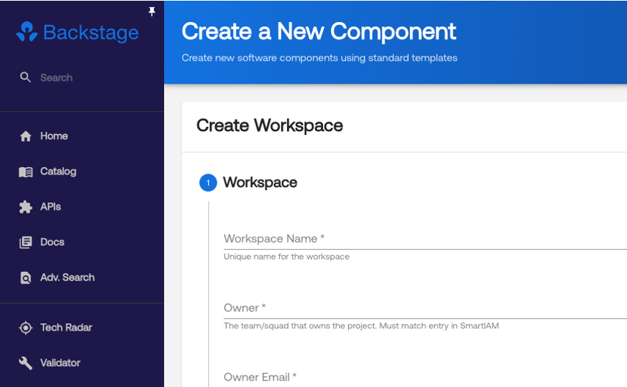
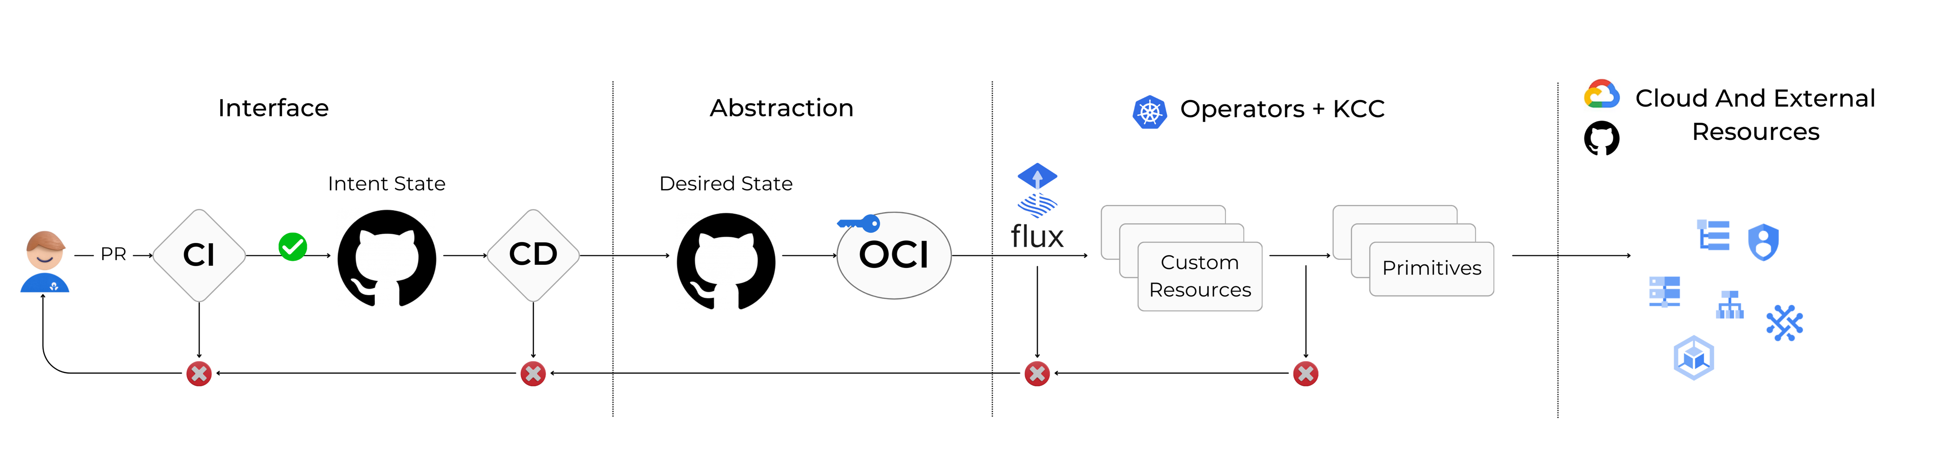
But why not Both?
$ x workspace create --name demo-workspace --env 'dev, sit, uat, prod’ –-enable-kube –-enable-cloudrun

Slide 7
Operators Intro and Challenges

Slide 8
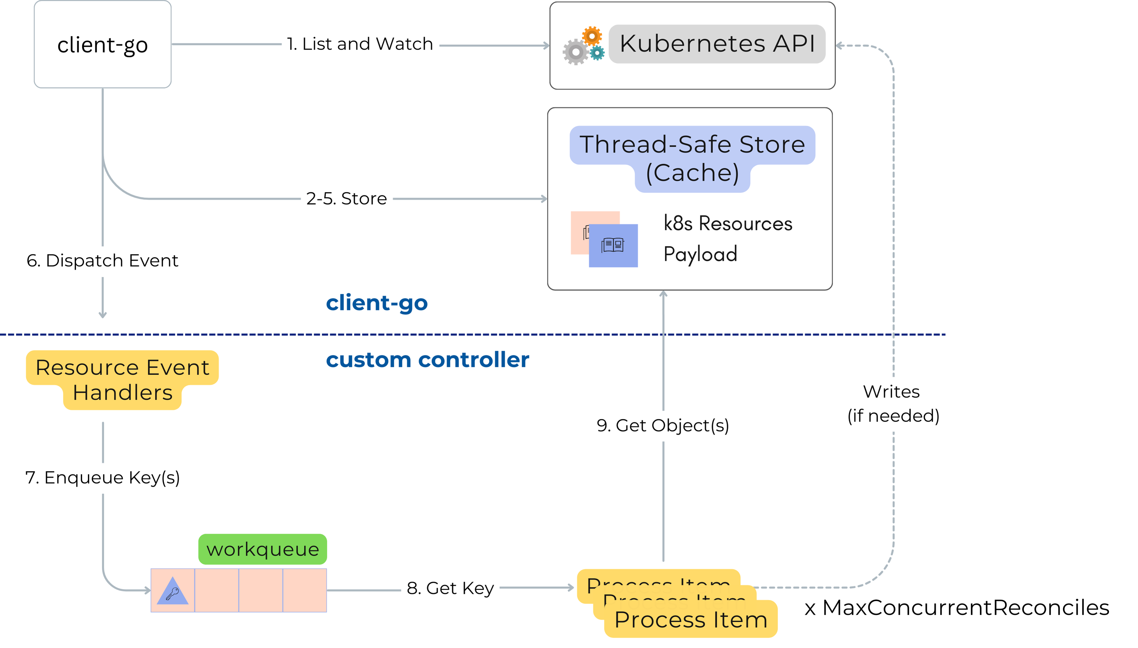

Reconciliation Loop
Full k8s payload is stored in memory for all relevant resources for all controllers
Everything is reconciled at once on start-up and each Cache Sync (10hrs)
Based on ”Client-go under the hood”
https://github.com/kubernetes/sample-controller/blob/master/docs/controller-client-go.md

Slide 9








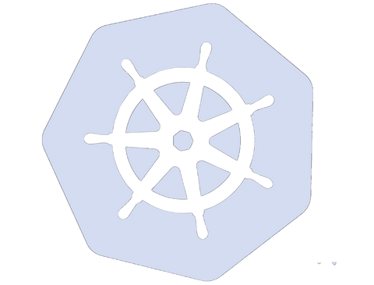
Operators: Software Engineering meets Kubernetes
Software
Engineering
Operators
Development
Isolated Go functions and logic.
Unit Test
Simulated in-memory k8s API server
Envtest
e2e Test
Declarative test in a real cluster (cloud or kind)
Performance Testing
Today’s focus

Slide 10
Performance Testing

Slide 11
Performance Testing
Load Test
Objectives
Test how system performs under load close to normal expected levels. Benchmark system performance to catch regressions
Define SLOs
Capacity planning
Regression detection
Performance troubleshooting
Inform design decisions
Stress Test
Test for system limits and breaking points by applying load higher than anticipated in normal operation. Useful for capacity planning, test graceful failure, plan Disaster Recovery.

Slide 12
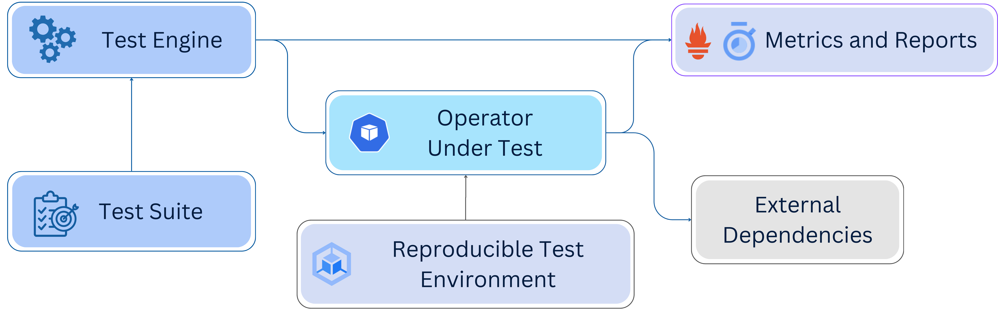
Load Test
Render and apply resources
Control concurrency
Multiple namespaces
Introduce controlled failures
Monitor and collect metrics
Cleanup
Compare results between runs
Assist in troubleshooting when an issue is identified
Resource templates
Test specification
Steps and expected outcomes
Cloud resources and other operators
Balance between mocking and representative real-world results
CPU & Memory requests == limits
Consistent state before run
Cluster environment
Rate limiting
Priority and Fairness

Slide 13
Load Test
Render and apply resources
Control concurrency
Multiple namespaces
Introduce controlled failures
Monitor and collect metrics
Cleanup
Compare results between runs
Assist in troubleshooting when an issue is identified
Resource templates
Test specification
Steps and expected outcomes
Cloud resources and other operators
Balance between mocking and representative real-world results
CPU & Memory requests == limits
Consistent state before run
Cluster environment
Rate limiting
Priority and Fairness

Slide 14

No Standard Load Testing Framework
No generic, standardised framework specifically designed for load testing Kubernetes operators.
01
Operators Load Test Challenges
CRs != HTTP Requests
Standard load testing tools are built with web traffic in mind. Can be used if operator’s functionality is exposed as API.
02
Targets and Dimensions
Unlike web-based apps load testing which are usually defined in terms of end-user volume, for operators it is harder to identify targets – number of services, teams or custom attributes?
03
External Resources
Creating external resources may incur undesirable cost. Emulating dependencies on the other hand, may lead to results that are not representative of real production performance.
04

Slide 15
Testing Frameworks

Slide 16
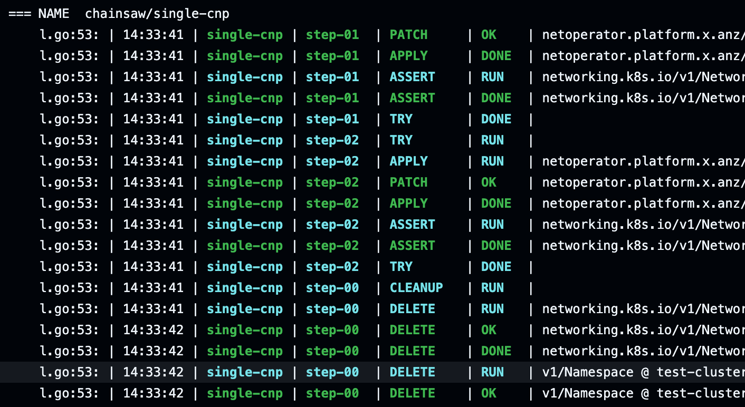

Declarative e2e Testing
apiVersion: chainsaw.kyverno.io/v1alpha1
kind: Test
metadata:
name: example
spec:
concurrent: false
timeouts:
apply: 10s
assert: 10s
error: 10s
steps:
- try:
- apply:
file: ../resources/good-resource.yaml
- try:
- assert:
file: ../resources/expected-result.yaml
- try:
- error:
file: ../resources/bad-resource.yaml
Notes:
https://github.com/cncf/artwork/blob/main/projects/kyverno/stacked/color/kyverno-stacked-color.png
https://kyverno.github.io/chainsaw/latest/test/explicit/

Slide 17


Cluster Loader 2
https://github.com/kubernetes/perf-tests/blob/master/clusterloader2/docs/design.md
+ Powerful test engine
+ Templating support
+ Concurrency and QPS support
+ Support for Generic Custom Resources
+ Step types: run, measure, report.
+ Built-in Prometheus or BYO
+ Open Source
+ Chaos features – need to explore more.
+ We don’t need to write our own tool
- Not designed as a generic operator testing framework
- Initial learning curve – docs are not descriptive enough, requires trial and error and diving in source code.
- OOTB measurements aimed for testing k8s components.
- Built in prometheus is not straight-forward.

Slide 18
test.yaml
my-cr-tmpl.yaml
name: LoadTest-MyTest
tuningSets:
- name: Parallel5
qpsLoad:
qps: 10
parallelism: 4
steps:
- name: run test
phases:
- tuningSet: Parallel5
replicasPerNamespace: 50
namespaceRange:
min: 1
max: 20
objectBundle:
- basename: cl2-cr
objectTemplatePath: ”my-cr-tmpl.yaml”
templateFillMap:
varName: “foo”
apiVersion: example.com/v1alpha1
kind: MyCr
metadata:
labels:
app: label
name: {{.Name}}
namespace: {{.Namespace}}
spec:
myKey: {{.varName}}
restOfTheSpec: ....
Concurrency configurable per phase
Deploy resources across namespaces “base-<sha>-1” to “base-<sha>-20”
Template vars

Slide 19
Measurements and Metrics
- name: Wait for objects to be ready
measurements:
- Method: WaitForGenericK8sObjects
Identifier: WaitForMyCR
Params:
objectGroup/Version/Resource
namespaceRange: ...
timeout: 200s
successfulConditions:
- Ready=True
minDesiredObjectCount: 1
maxFailedObjectCount: 1
- name: Start measurements
measurements:
- Identifier: gq
Method: GenericPrometheusQuery
Params:
action: start
metricName: Controller reconcile
metricVersion: v1
unit: total
queries:
- name: reconcileTimeSeconds
query: <prom-query>
- name: Gather measurements
measurements:
- Identifier: gq
Method: GenericPrometheusQuery
Params:
action: gather
enableViolations: true
More methods supported for core k8s components metrics

Slide 20
Q & A

